Slide 1

Linear Regression
John William Embate

Slide 2
What is Linear Regression?
Linear Regression is a machine learning algorithm based on supervised learning. It performs a regression task.
Regression models a target prediction value based on independent variables.
It is mostly used for finding out the relationship between variables and forecasting.
Example applications: Predicting the price of a house in Cebu City based on specific features/independent variables such as age of the house, area of land in sq. m, no. of bedrooms, no. of floors, and etc.
Other applications: Predicting stock prices, Predicting monthly/yearly sales/revenue of a company, and etc.

Slide 3
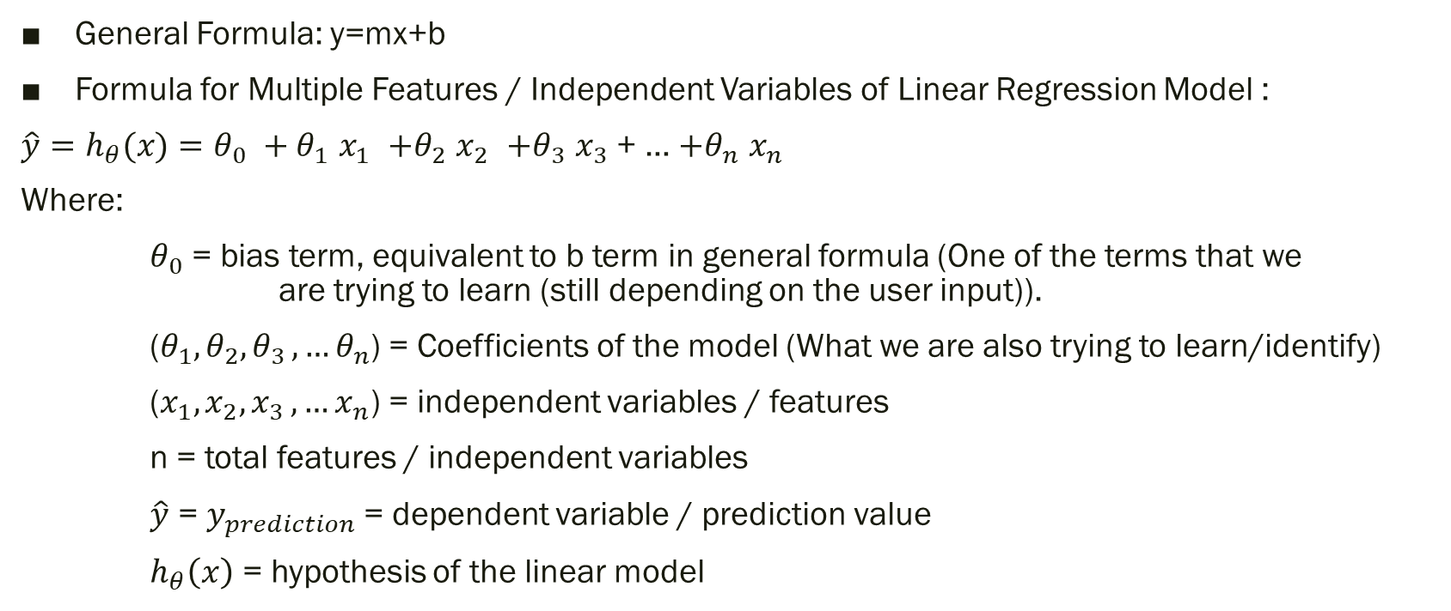
Linear Model / Linear Equation
General Formula: y=mx+b
Formula for Multiple Features / Independent Variables of Linear Regression Model :
$\hat{y}=h_{θ}(x)=θ_{0 }+{θ_{1 }x}_{1 }$ $+θ_{2 }x_{2 }$ $+θ_{3 }x_{3 }$+ … $+θ_{n }x_{n }$
Where:
$θ_{0 }$= bias term, equivalent to b term in general formula (One of the terms that we are trying to learn (still depending on the user input)).
($θ_{1},θ_{2}{,θ}_{3},…θ_{n}$) = Coefficients of the model (What we are also trying to learn/identify)
($x_{1},x_{2}{,x}_{3},…x_{n}$) = independent variables / features
n = total features / independent variables
$\hat{y}$ = $y_{prediction}$= dependent variable / prediction value
$h_{θ}\left(x\right)$ = hypothesis of the linear model

Slide 4
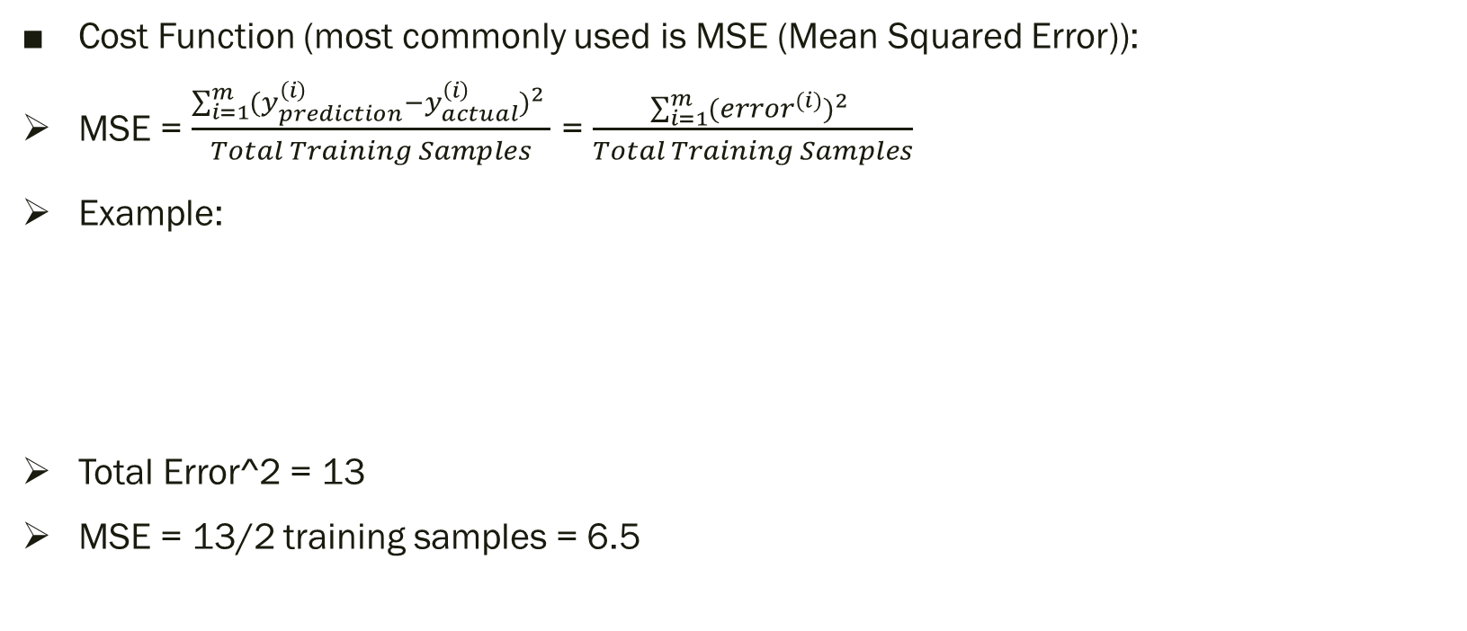
Cost Function of Non-Regularized Linear Regression:
Cost Function (most commonly used is MSE (Mean Squared Error)):
MSE = ${\frac{\sum_{i=1}^{m}{{(y_{prediction}^{\left(i\right)}−y_{actual}^{\left(i\right)})}^{2} }}{Total Training Samples}}_{ }$= $\frac{\sum_{i=1}^{m}{{({error}^{(i)})}^{2} }}{Total Training Samples}$
Example:
Total Error^2 = 13
MSE = 13/2 training samples = 6.5
y_prediction | y_actual | error | error ^ 2
4 | 2 | 2 | 4
3 | 6 | -3 | 9

Slide 5
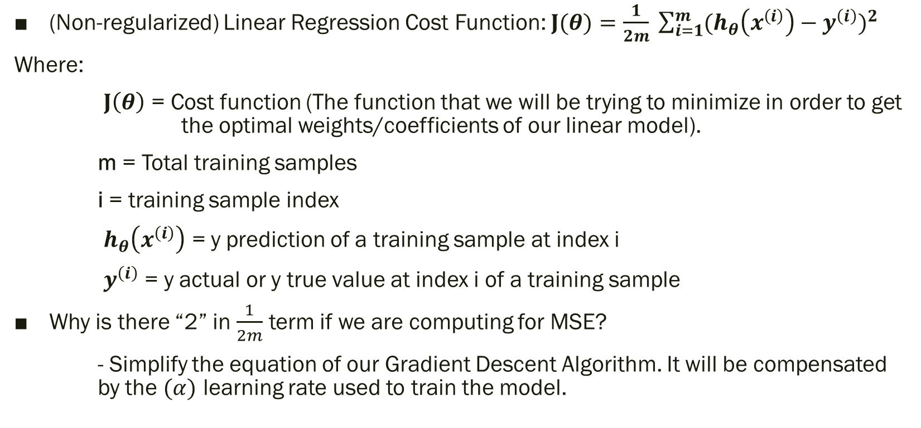
Cost Function of Non-Regularized Linear Regression (cont.) :
(Non-regularized) Linear Regression Cost Function: $J(θ)=$ $\frac{1}{2m} \sum_{i=1}^{m}{{(h_{θ}\left(x^{\left(i\right)}\right)−y^{\left(i\right)})}^{2} }$
Where:
$J\left(θ\right)$ = Cost function (The function that we will be trying to minimize in order to get the optimal weights/coefficients of our linear model).
m = Total training samples
i = training sample index
$h_{θ}\left(x^{\left(i\right)}\right)$ = y prediction of a training sample at index i
$y^{\left(i\right)}$ = y actual or y true value at index i of a training sample
Why is there “2” in $\frac{1}{2m}$ term if we are computing for MSE?
- Simplify the equation of our Gradient Descent Algorithm. It will be compensated by the $(α)$ learning rate used to train the model.

Slide 6
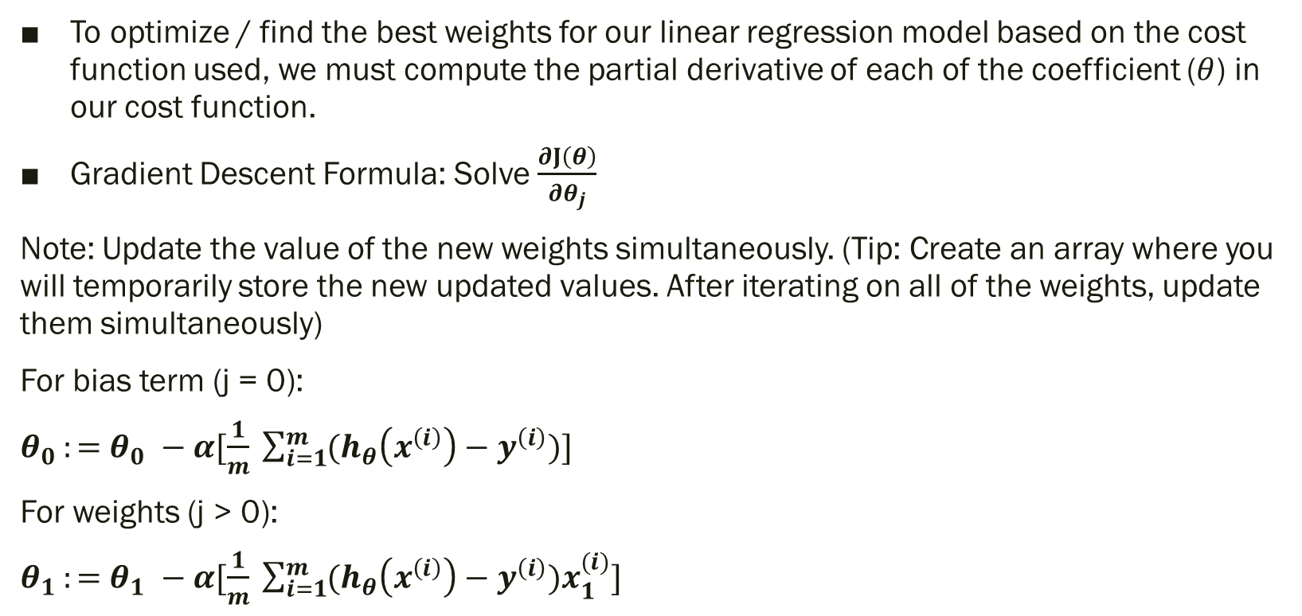
Gradient Descent Algorithm of Non-Regularized Linear Regression:
To optimize / find the best weights for our linear regression model based on the cost function used, we must compute the partial derivative of each of the coefficient ($θ$) in our cost function.
Gradient Descent Formula: Solve $\frac{∂J\left(θ\right)}{∂θ_{j}}$
Note: Update the value of the new weights simultaneously. (Tip: Create an array where you will temporarily store the new updated values. After iterating on all of the weights, update them simultaneously)
For bias term (j = 0):
$θ_{0 }:=$ $θ_{0} −α[\frac{1}{m} \sum_{i=1}^{m}{(h_{θ}\left(x^{\left(i\right)}\right)−y^{\left(i\right)})}]$
For weights (j > 0):
$θ_{1 }:=$ $θ_{1} −α[\frac{1}{m} \sum_{i=1}^{m}{(h_{θ}\left(x^{\left(i\right)}\right)−y^{\left(i\right)})x_{1}^{(i)}}]$

Slide 7
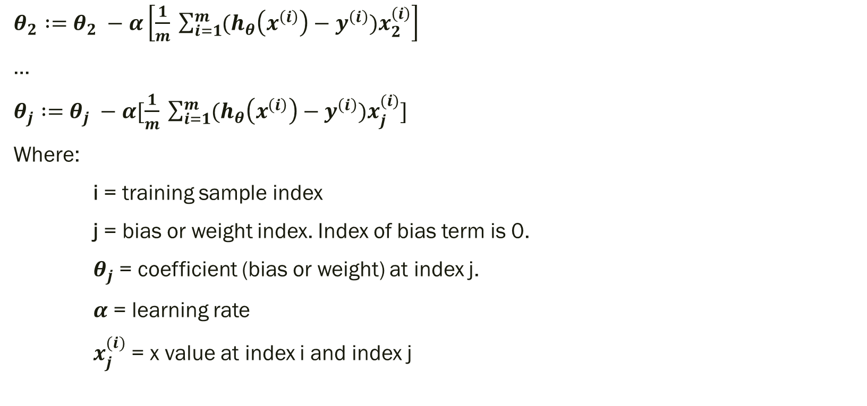
Gradient Descent Algorithm of Non-Regularized Linear Regression:
$θ_{2} :=$ $θ_{2} −α\left[\frac{1}{m} \sum_{i=1}^{m}{(h_{θ}\left(x^{\left(i\right)}\right)−y^{\left(i\right)})x_{2}^{\left(i\right)}}\right]$
…
$θ_{j} :=$ $θ_{j} −α[\frac{1}{m} \sum_{i=1}^{m}{(h_{θ}\left(x^{\left(i\right)}\right)−y^{\left(i\right)})x_{j}^{(i)}}]$
Where:
i = training sample index
j = bias or weight index. Index of bias term is 0.
$θ_{j}$ = coefficient (bias or weight) at index j.
$α$ = learning rate
$x_{j}^{(i)}$ = x value at index i and index j

Slide 8
Overall Algorithm
Initialize previous_cost, current_cost, weights to zero.
Set tolerance value to 0.0001 (can be changed) to break out of for loop.
Standardize x_values.
for (i in range(max_iteration))
{
weights = compute_gradient_descent() //update weights
previous_cost = current_cost
current_cost = compute_cost_function()
if(|prev_cost – current_cost| < tolerance) { break }
//optional: print the current cost to visually check the convergence of the model
}
Get or print the unstandardized values of the weights.
Validate and Test your model using other dataset where the model wasn’t trained on.

Slide 9
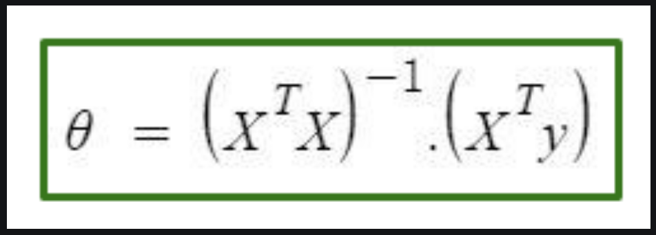
Optional / Advanced (Normal Equation)
Normal Equation is an analytical approach to Linear Regression with a Least Square Cost Function.
We can directly find out the value of θ without using Gradient Descent. Following this approach is an effective and time-saving option when working with a dataset with small features.
Normal Equation method is based on the mathematical concept of Maxima & Minima in which the derivative and partial derivative of any function would be zero at the minima and maxima point.
So, in Normal Equation method, we get the minimum value of the Cost function by finding its partial derivative w.r.t to each weight and equating it to zero.
Normal Equation:

Slide 10
LINAER REGRESSION WITH REGULARIZATION
RIDGE (L2 penalty), LASSO(L1 penalty), AND ELASTIC NET (L1 + L2 penalty)

Slide 11
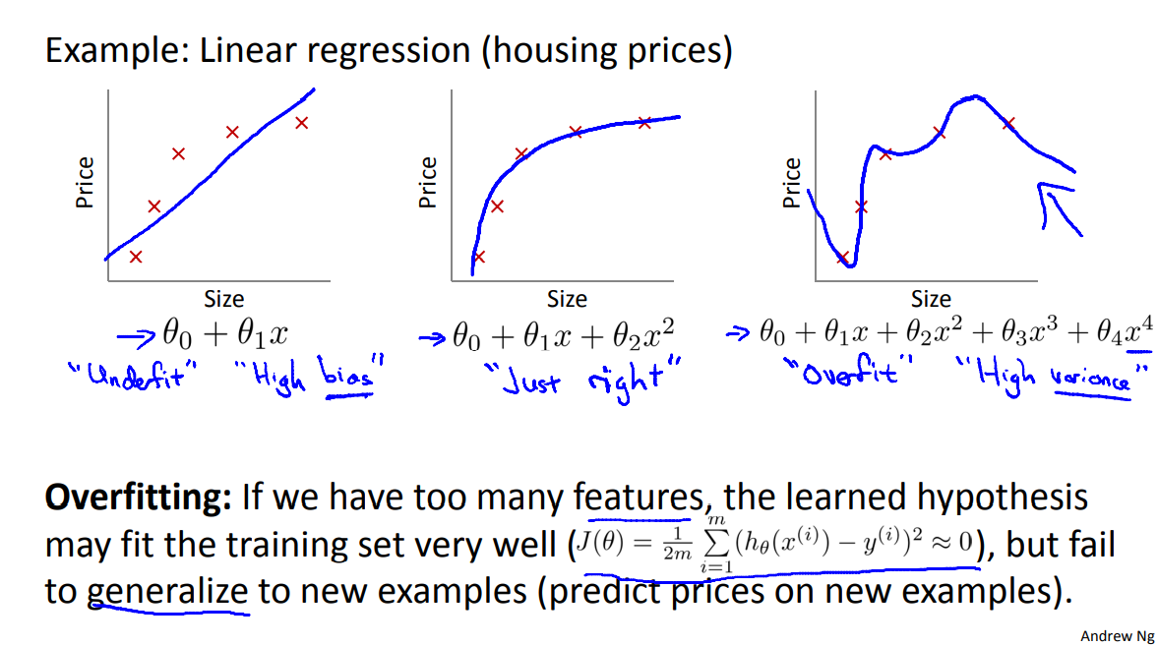
The problem of overfitting:

Slide 12
Ridge Regression
L2 regularization

Slide 13
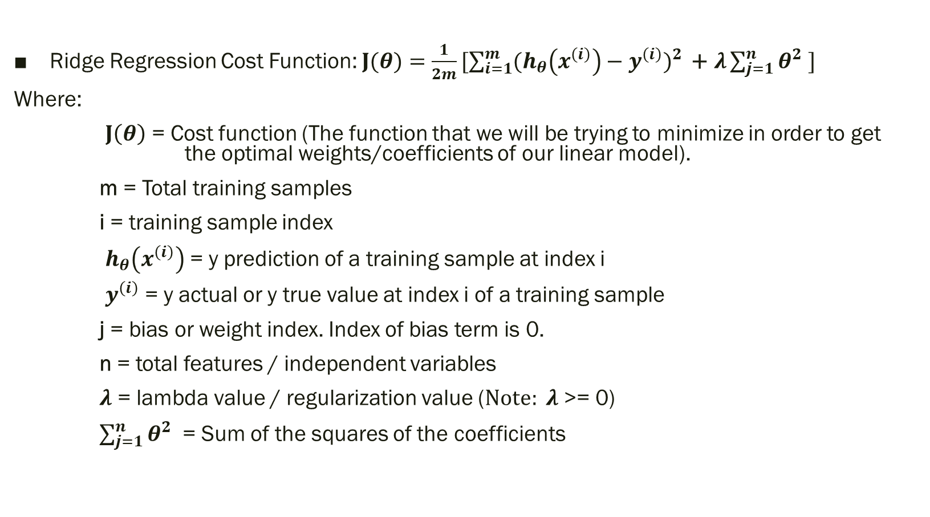
Cost Function of Ridge Regression:
Ridge Regression Cost Function: $J(θ)=$ $\frac{1}{2m}[\sum_{i=1}^{m}{{(h_{θ}\left(x^{\left(i\right)}\right)−y^{\left(i\right)})}^{2} }\text{+} λ\sum_{j=1}^{n}{θ^{2} }]$
Where:
$J\left(θ\right)$ = Cost function (The function that we will be trying to minimize in order to get the optimal weights/coefficients of our linear model).
m = Total training samples
i = training sample index
$h_{θ}\left(x^{\left(i\right)}\right)$ = y prediction of a training sample at index i
$y^{\left(i\right)}$ = y actual or y true value at index i of a training sample
j = bias or weight index. Index of bias term is 0.
n = total features / independent variables
$λ$ = lambda value / regularization value ($Note: λ$ >= 0)
$\sum_{j=1}^{n}{θ^{2} }$ = Sum of the squares of the coefficients

Slide 14
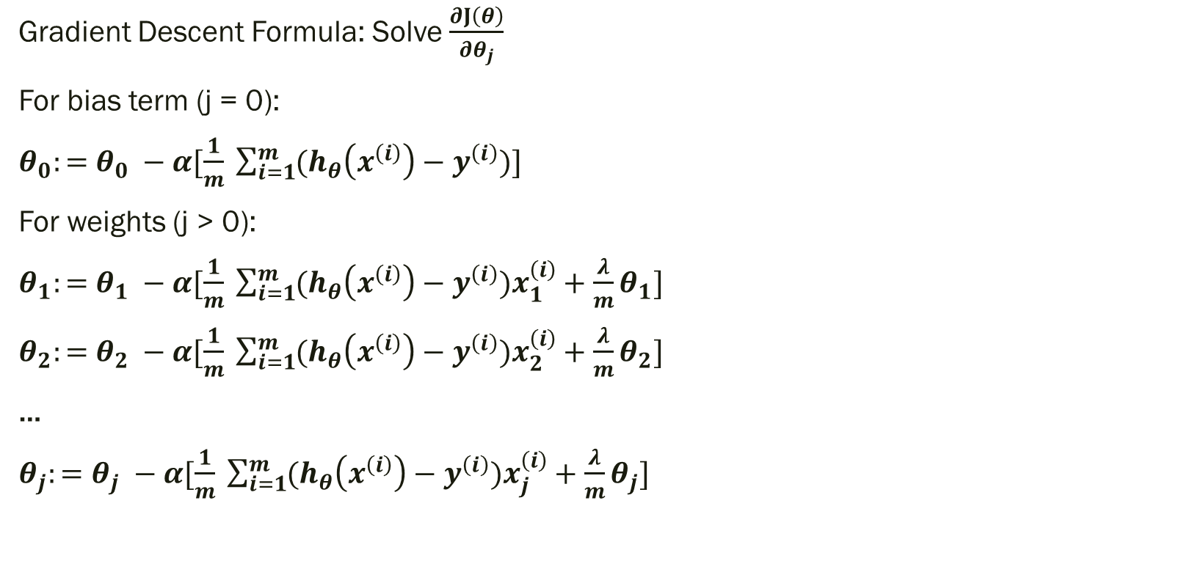
Gradient Descent of Ridge Regression:
Gradient Descent Formula: Solve $\frac{∂J\left(θ\right)}{∂θ_{j}}$
For bias term (j = 0):
$θ_{0}:=$ $θ_{0} −α[\frac{1}{m} \sum_{i=1}^{m}{(h_{θ}\left(x^{\left(i\right)}\right)−y^{\left(i\right)})}]$
For weights (j > 0):
$θ_{1}:=$ $θ_{1} −α[\frac{1}{m} \sum_{i=1}^{m}{(h_{θ}\left(x^{\left(i\right)}\right)−y^{\left(i\right)})x_{1}^{\left(i\right)}}+\frac{λ}{m}θ_{1}]$
$θ_{2}:=$ $θ_{2} −α[\frac{1}{m} \sum_{i=1}^{m}{(h_{θ}\left(x^{\left(i\right)}\right)−y^{\left(i\right)})x_{2}^{\left(i\right)}}+\frac{λ}{m}θ_{2}]$
…
$θ_{j}:=$ $θ_{j} −α[\frac{1}{m} \sum_{i=1}^{m}{(h_{θ}\left(x^{\left(i\right)}\right)−y^{\left(i\right)})x_{j}^{\left(i\right)}}+\frac{λ}{m}θ_{j}]$

Slide 15
LAsso Regression
L1 regularization

Slide 16
What makes LASSO special?
LASSO means Least Absolute Shrinkage and Selection Operator.
LASSO can be used for feature selection by shrinking the coefficients of variables that are deemed useless or insignificant to zero.
As a result, LASSO can aid in the improvement of a linear regression model's performance in terms of the Adjusted R2 score metric. It can also improve model prediction speed because there are fewer variables to consider during computation once the term/s in the linear regression model with a zero coefficient are removed.

Slide 17
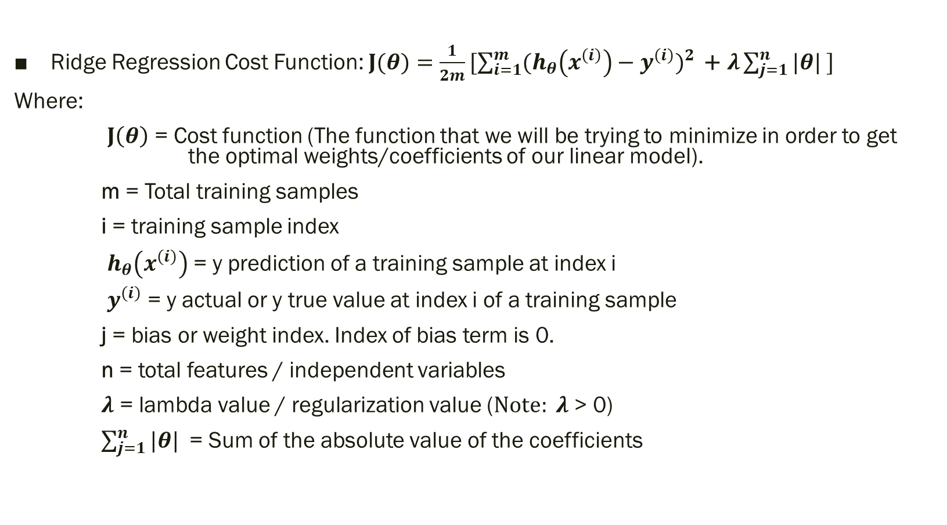
Cost Function of Lasso Regression:
Ridge Regression Cost Function: $J(θ)=$ $\frac{1}{2m}[\sum_{i=1}^{m}{{(h_{θ}\left(x^{\left(i\right)}\right)−y^{\left(i\right)})}^{2} }\text{+} λ\sum_{j=1}^{n}{|θ| }]$
Where:
$J\left(θ\right)$ = Cost function (The function that we will be trying to minimize in order to get the optimal weights/coefficients of our linear model).
m = Total training samples
i = training sample index
$h_{θ}\left(x^{\left(i\right)}\right)$ = y prediction of a training sample at index i
$y^{\left(i\right)}$ = y actual or y true value at index i of a training sample
j = bias or weight index. Index of bias term is 0.
n = total features / independent variables
$λ$ = lambda value / regularization value ($Note: λ$ > 0)
$\sum_{j=1}^{n}{|θ| }$ = Sum of the absolute value of the coefficients

Slide 18

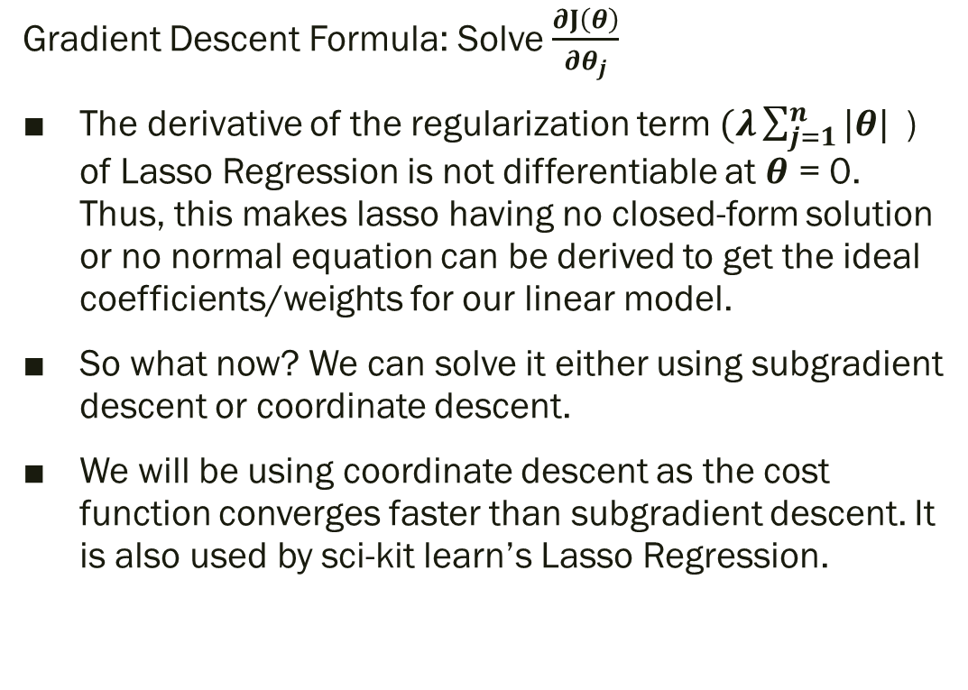
Gradient Descent of Lasso Regression:
Gradient Descent Formula: Solve $\frac{∂J\left(θ\right)}{∂θ_{j}}$
The derivative of the regularization term $(λ\sum_{j=1}^{n}{|θ| }$) of Lasso Regression is not differentiable at $θ$ = 0. Thus, this makes lasso having no closed-form solution or no normal equation can be derived to get the ideal coefficients/weights for our linear model.
So what now? We can solve it either using subgradient descent or coordinate descent.
We will be using coordinate descent as the cost function converges faster than subgradient descent. It is also used by sci-kit learn’s Lasso Regression.

Slide 19
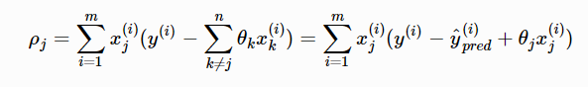
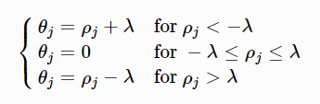
Coordinate Descent for Lasso Regression:
Compute for the OLS term without including the coefficient we would like to update.
Soft threshold function to update the coefficient.

Slide 20
ELASTIC NET Regression
L1 + L2 regularization

Slide 21
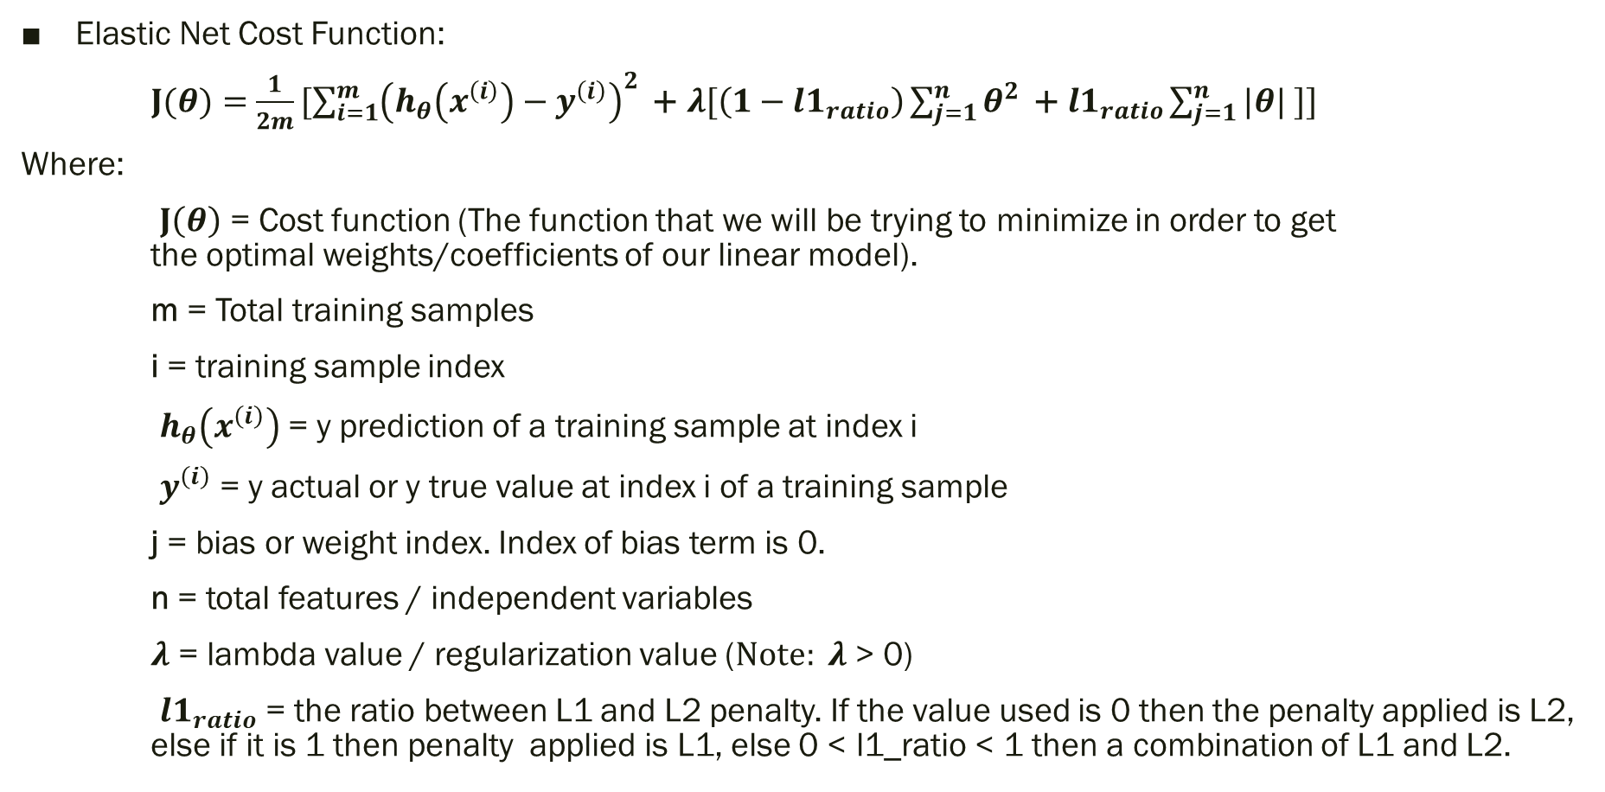
Cost Function of Elastic Net Regression:
Elastic Net Cost Function:
$J(θ)=$ $\frac{1}{2m}[\sum_{i=1}^{m}{{\left(h_{θ}\left(x^{\left(i\right)}\right)−y^{\left(i\right)}\right)}^{2} }\text{+} λ[\left(1−{l1}_{ratio}\right)\sum_{j=1}^{n}{θ^{2} }\text{+} {l1}_{ratio}\sum_{j=1}^{n}{|θ| }]]$
Where:
$J\left(θ\right)$ = Cost function (The function that we will be trying to minimize in order to get the optimal weights/coefficients of our linear model).
m = Total training samples
i = training sample index
$h_{θ}\left(x^{\left(i\right)}\right)$ = y prediction of a training sample at index i
$y^{\left(i\right)}$ = y actual or y true value at index i of a training sample
j = bias or weight index. Index of bias term is 0.
n = total features / independent variables
$λ$ = lambda value / regularization value ($Note: λ$ > 0)
${l1}_{ratio}$ = the ratio between L1 and L2 penalty. If the value used is 0 then the penalty applied is L2, else if it is 1 then penalty applied is L1, else 0 < l1_ratio < 1 then a combination of L1 and L2.

Slide 22
Other things to Consider when developing ML models:
Hyperparameter Tuning
Grid Search
Randomized Search
Data Normalization & Standardization
Data Leak
Training, Testing, and Validation
Cross Validation
Leave One Out
K Fold
Stratified K Fold
Stratified Shuffle Split
Etc.
Feature Engineering
Data Cleaning
Feature Selection
Concept Drift
Multicollinearity
Etc.

Slide 23
Sources:
ML | Linear Regression - GeeksforGeeks
ML | Normal Equation in Linear Regression – GeeksforGeeks
Lasso regression: implementation of coordinate descent — Data Blog (xavierbourretsicotte.github.io)
Lasso Regression Explained, Step by Step (machinelearningcompass.com)
userR.dvi (su.domains)
Andrew Ng Machine Learning Coursera

